Slide 1


Introduction to
Diffusion Language Models
Woojin Kim
SNU AIDAS Lab
wjk9904@snu.ac.kr

Slide 2
Table of contents
Goals of the Seminar
1
The Diffusion Breakthrough
To understand the foundational formulas behind diffusion models
2
Revolutionizing Vision with Diffusion
To explore the key components that make up a diffusion model
3
Inside the Diffusion Process
To gain insight into how diffusion models can be integrated into one’s own research
4
Bringing Diffusion to Language
5
Diffusion Language Models Today
6
Seminar Schedule

Slide 3
The Diffusion Breakthrough

Slide 4
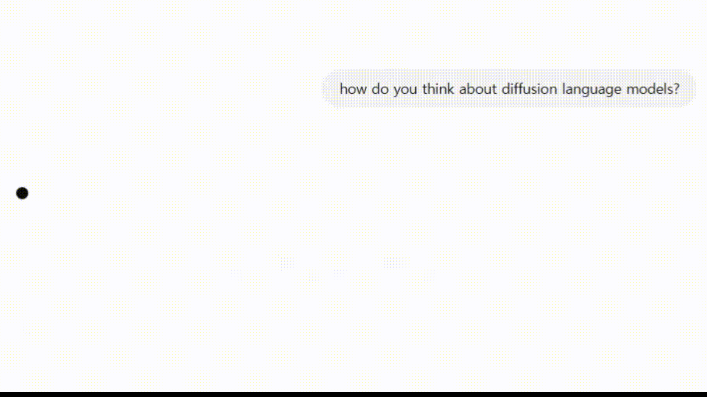
Rethinking Language Generation
1. The Diffusion Breakthrough
Auto-regressive models (GPT, Qwen) currently dominate the field, but they generate text one token at a time. Is this truly the most optimal approach?

Slide 5
Rethinking Language Generation
1. The Diffusion Breakthrough
Auto-regressive models (GPT, Qwen) currently dominate the field, but they generate text one token at a time. Is this truly the most optimal approach?
“What if we could generate coherent paragraphs without going one token at a time?”

Slide 6
A New Paradigm: Diffusion-based generation
1. The Diffusion Breakthrough
I
love
pineapple
pizza
I
love
pineapple
pizza
Auto-regressive
Language Model
Diffusion
Language Model
Input Prompt
Input Prompt
What is your favorite food?
What is your favorite food?
One token at a time
Multiple tokens at a time

Slide 7
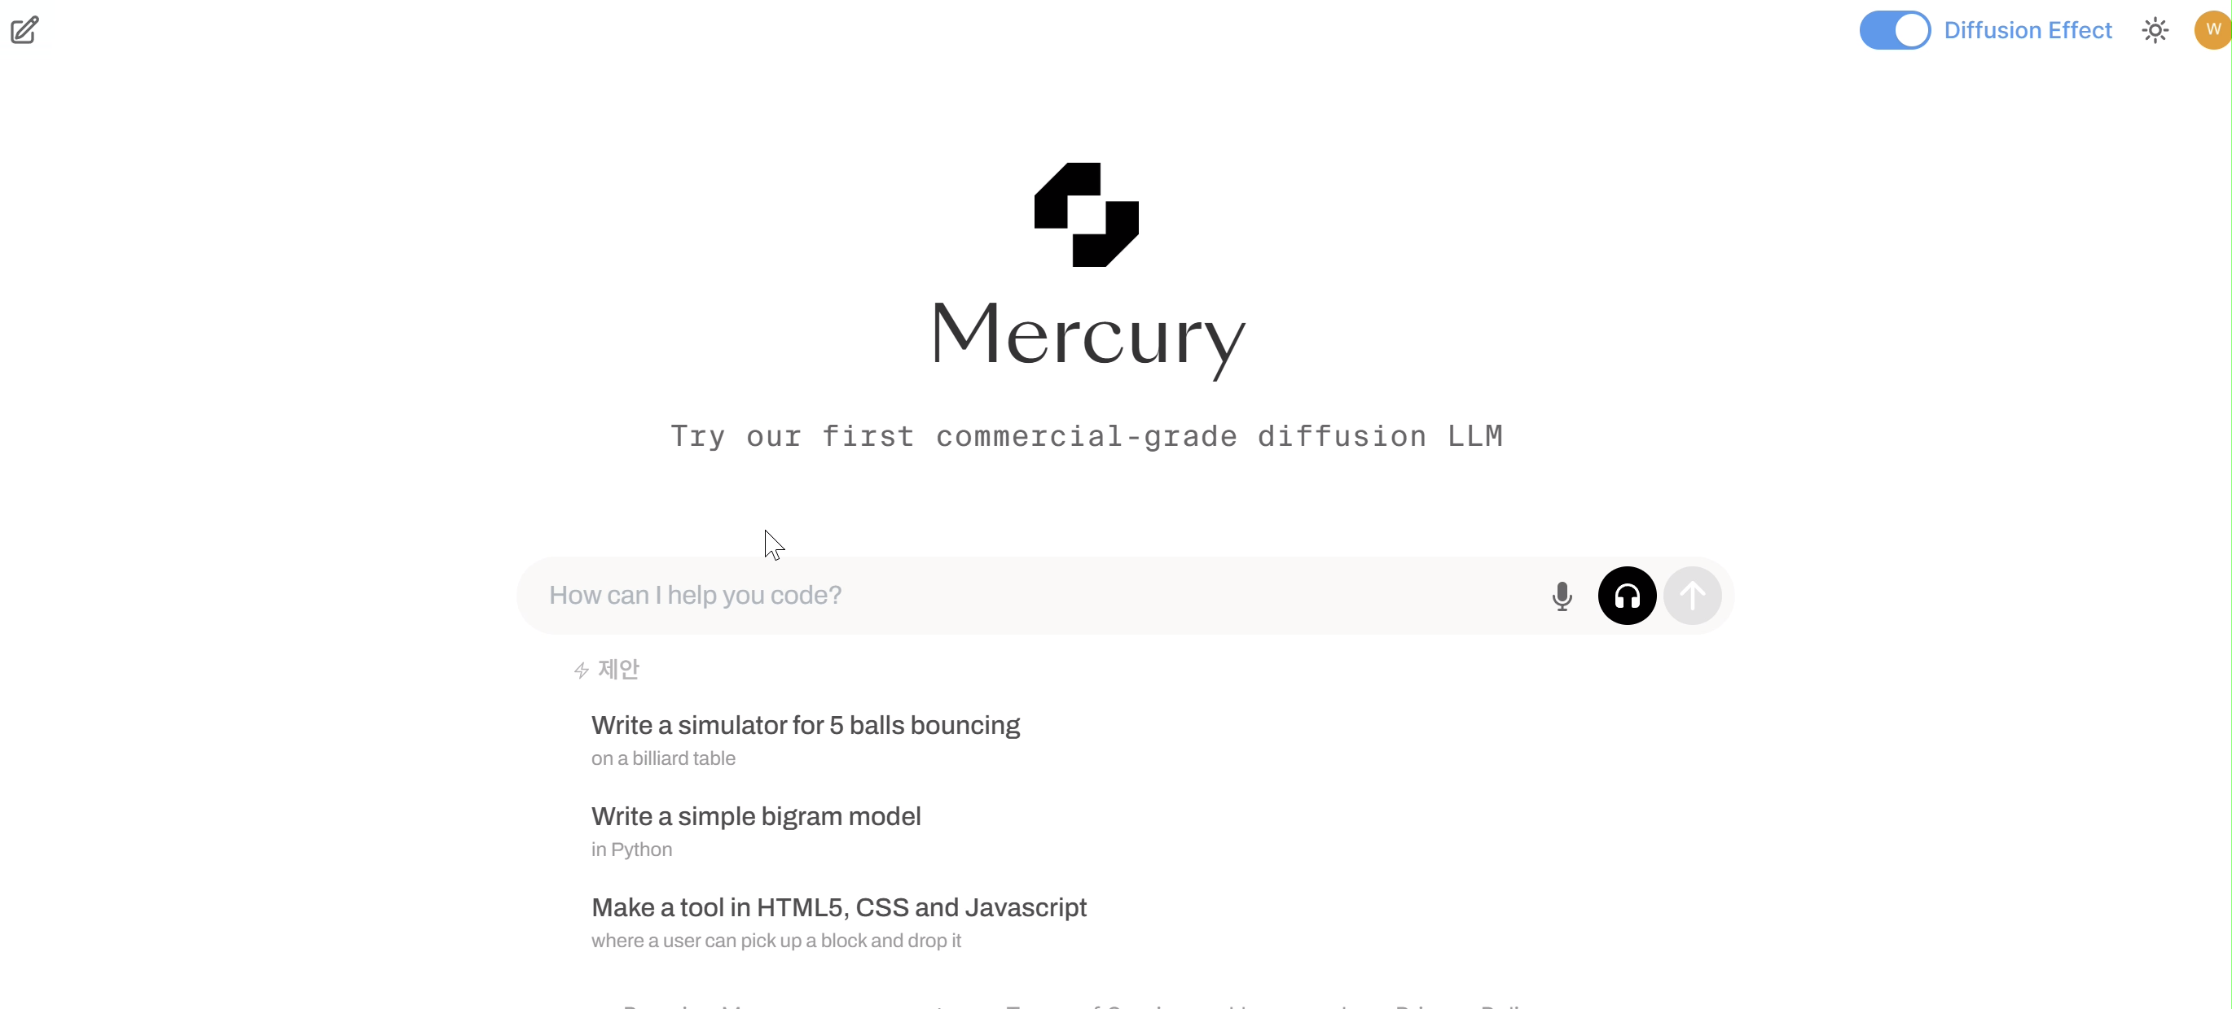
Mercury Coder
1. The Diffusion Breakthrough

Slide 8
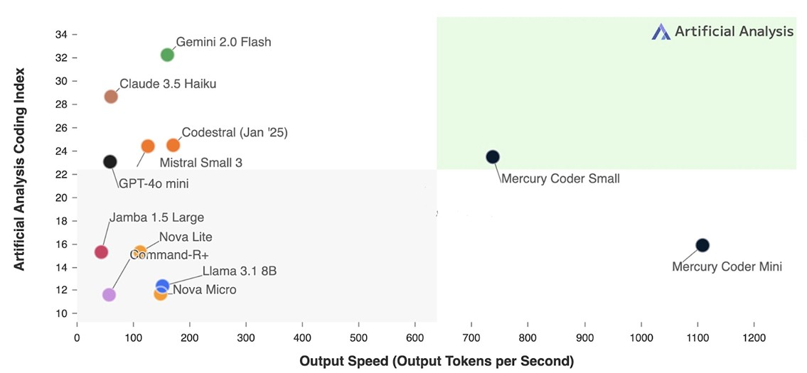
Mercury Coder
1. The Diffusion Breakthrough
4~5 times faster
(https://www.inceptionlabs.ai/introducing-mercury)

Slide 9
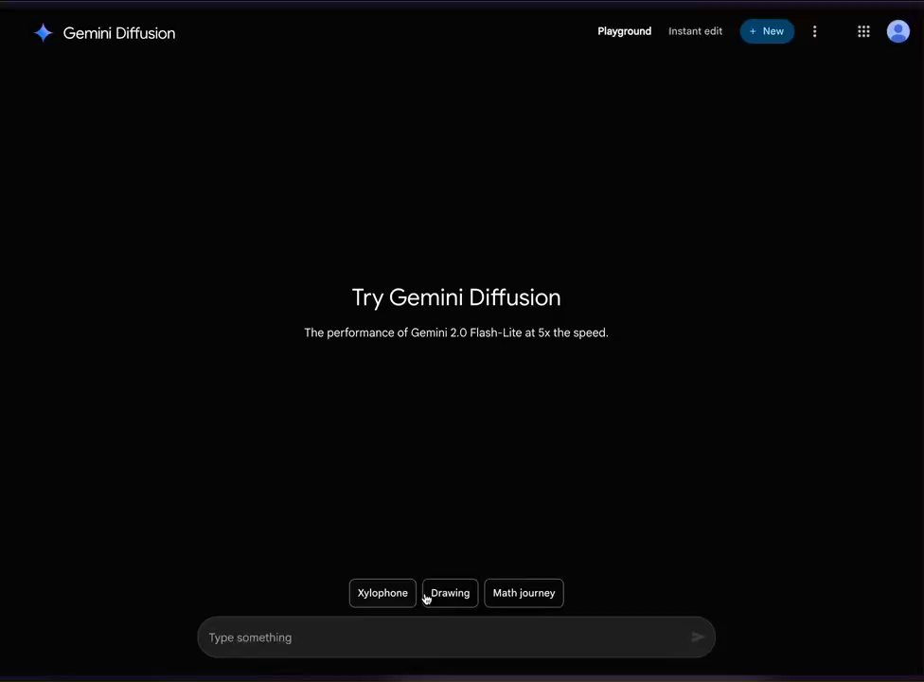
Gemini Diffusion
1. The Diffusion Breakthrough

Slide 10
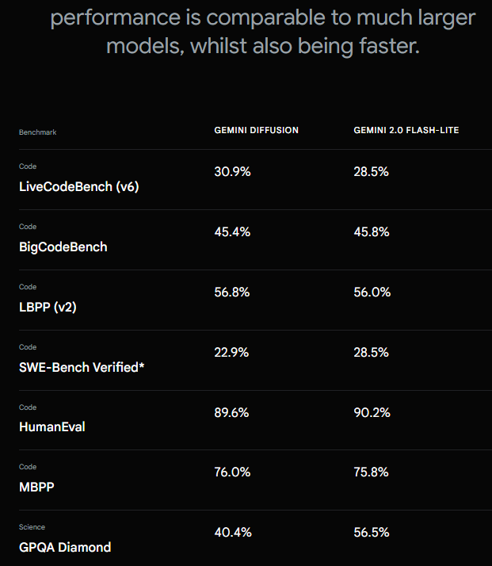
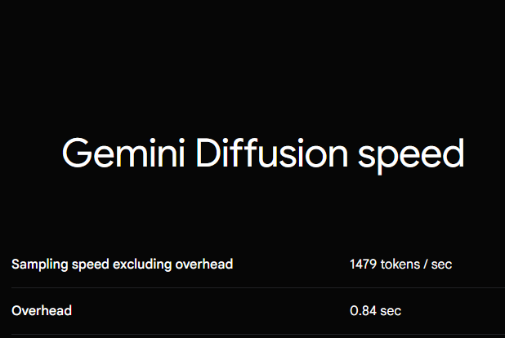
Gemini Diffusion
1. The Diffusion Breakthrough

Slide 11
Revolutionizing Vision with Diffusion

Slide 12
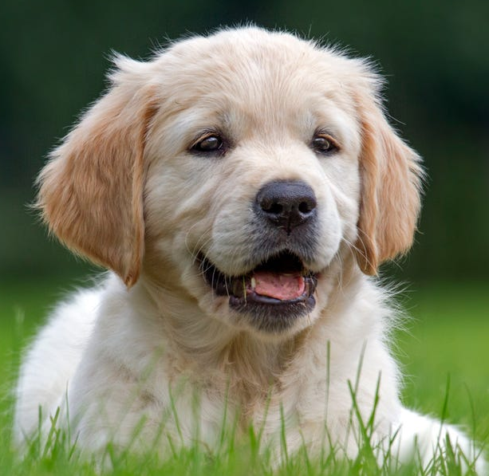
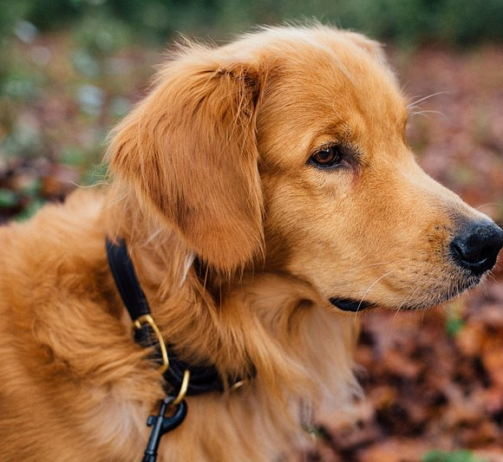
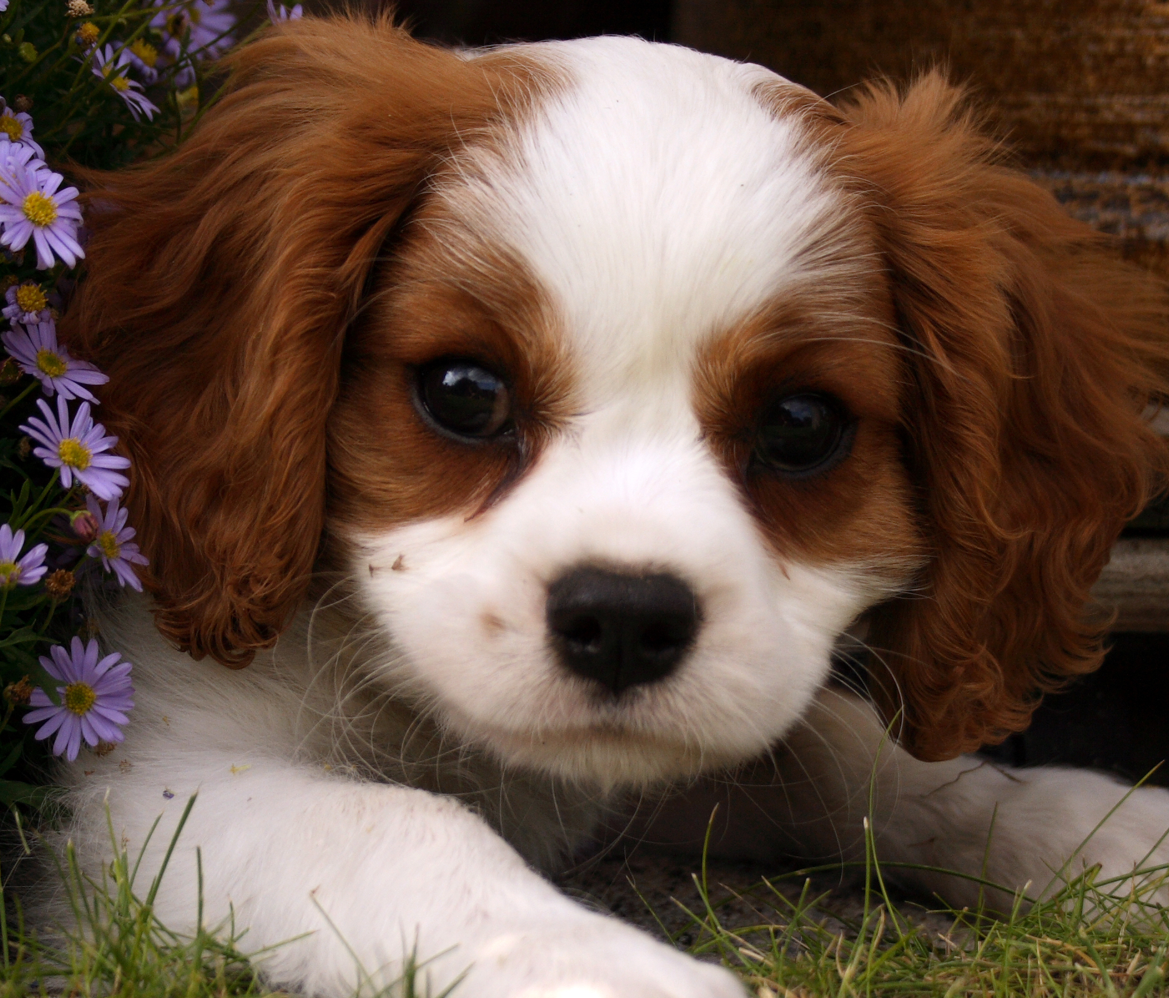
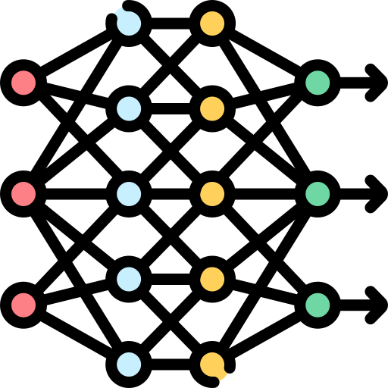
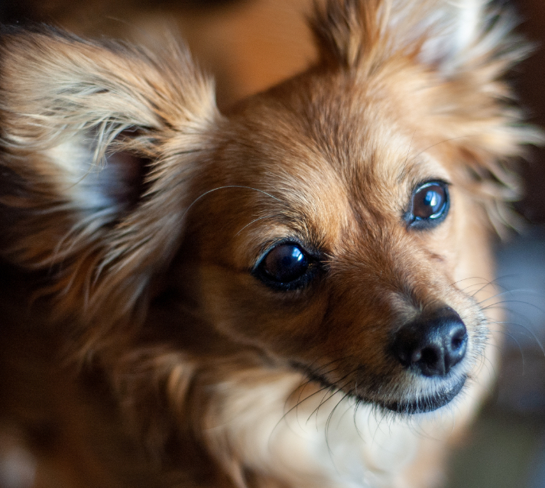
Deep Generative Models
2. Diffusion in Vision
Generative Models: Models that learn data patterns to generate new, realistic examples.
Objective: To train a model $p(x)$ that approximates the true data distribution $P_{data}(x)$
True Data Distribution
Sampled Data Distribution
Neural Networks
???
Sample
Train
Generate

Slide 13
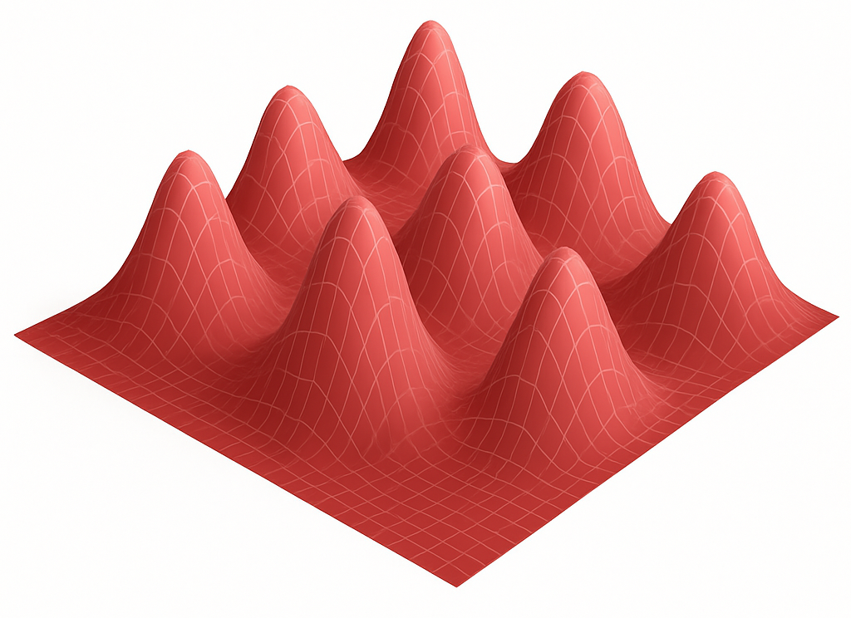
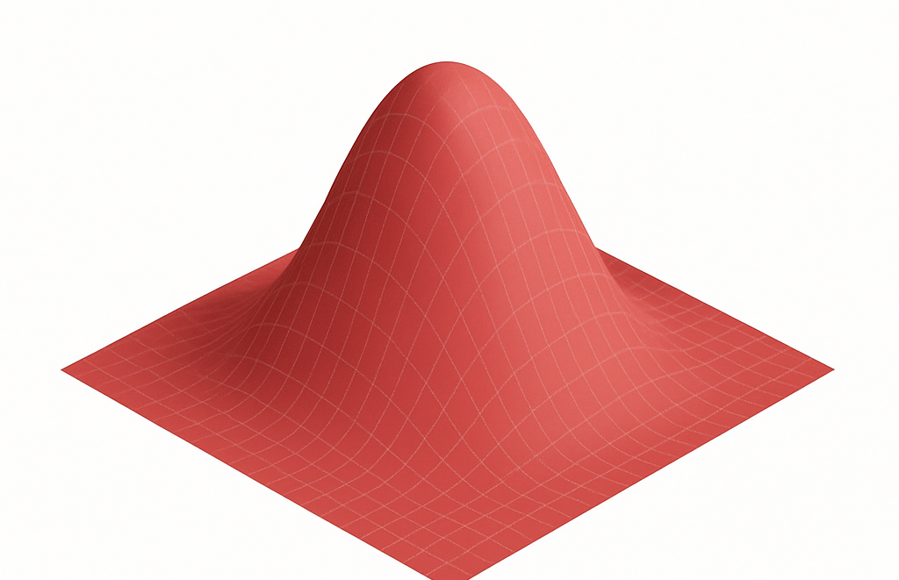
Deep Generative Models
2. Diffusion in Vision
Even though we can sample data, we want to train a model that learns to generate it
However, this is hard because:
Real data lies in a high-dimensional, complex space
We usually start from a simple distribution (like a standard Gaussian)
Learning the transformation from a simple latent space to real data is non-trivial
Complex data distribution
Simple prior
learning direct transformation
is hard

Slide 14
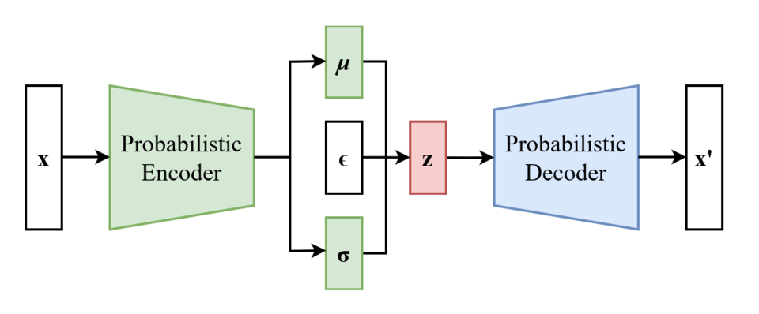
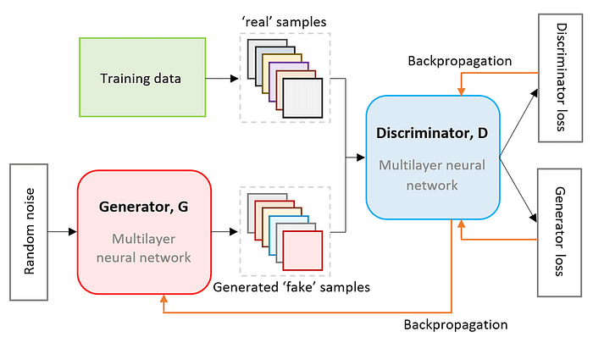
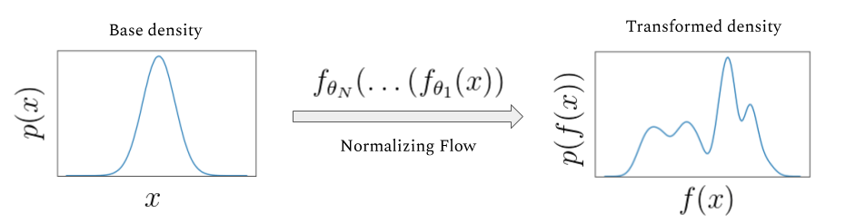
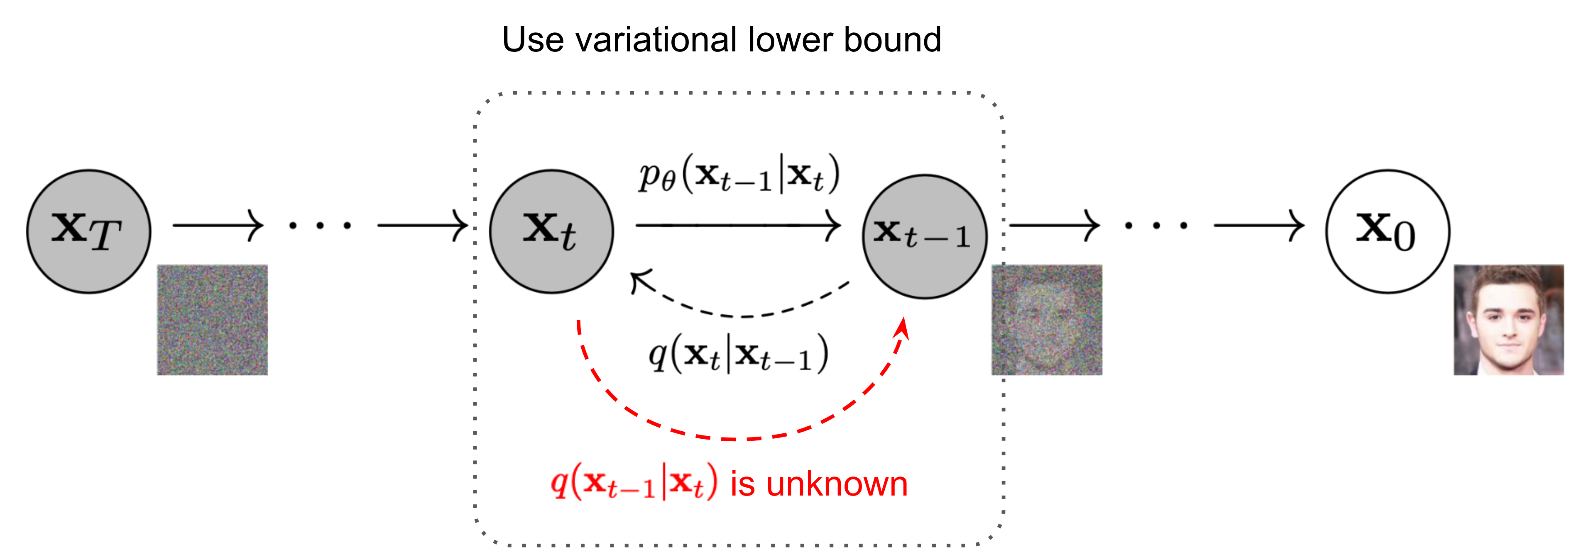
Deep Generative Models
2. Diffusion in Vision
VAE (Kingma & Welling, 2013)
GAN (Goodfellow et al., 2014)
(https://commons.wikimedia.org/wiki/File:Reparameterized_Variational_Autoencoder.png)
(https://arxiv.org/abs/2112.01925)
Normalizing Flow (Rezende & Mohamed, 2015)
Diffusion Model (Ho et al., 2020)
(https://siboehm.com/articles/19/normalizing-flow-network)
(https://arxiv.org/abs/2006.11239)

Slide 15
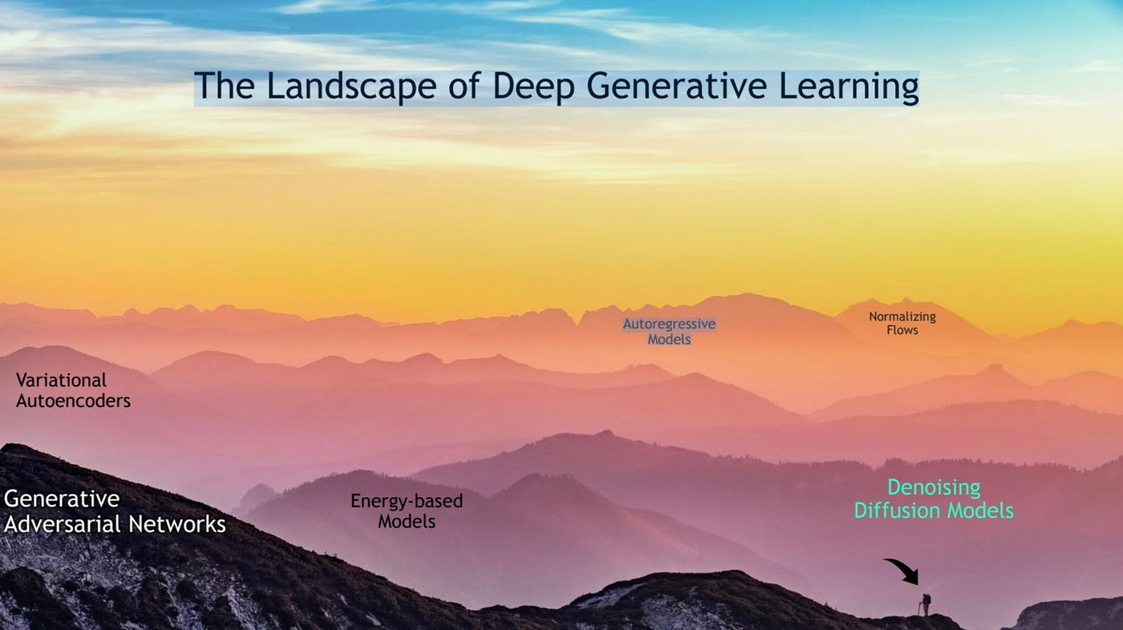
2. Diffusion in Vision
(CVPR 2022 Tutorial: Denoising Diffusion-based Generative Modeling: Foundations and Applications)

Slide 16
The Era of Diffusion Model
2. Diffusion in Vision
VAE
GAN
DCGAN,
StyleGAN,
DDPM, DDIM,
Dall-E
Stable Diffusion, Imagen
ControlNet,
DiT
WGAN
BigGAN
VAE
GAN
Diffusion
?
2013
2014
2021

Slide 17

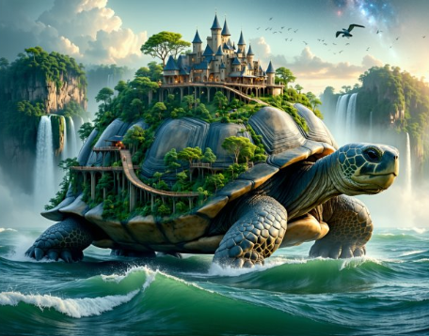
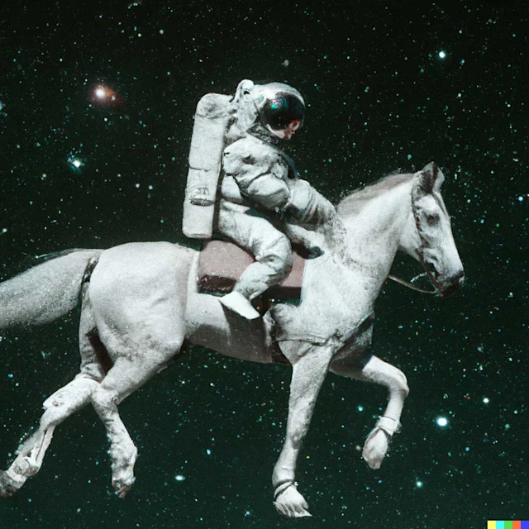
Application: Text to Image Generation
2. Diffusion in Vision
Imagen
(Google)
Stable Diffusion
(Stability AI)
DaLL•E
(OpenAI)
A small cactus wearing a straw hat and neon sunglasses in the Sahara desert.
Scene of a giant ancient tortoise with a fantasy city built on its back. The tortoise's shell …
A photorealistic image of an astronaut riding a horse

Slide 18
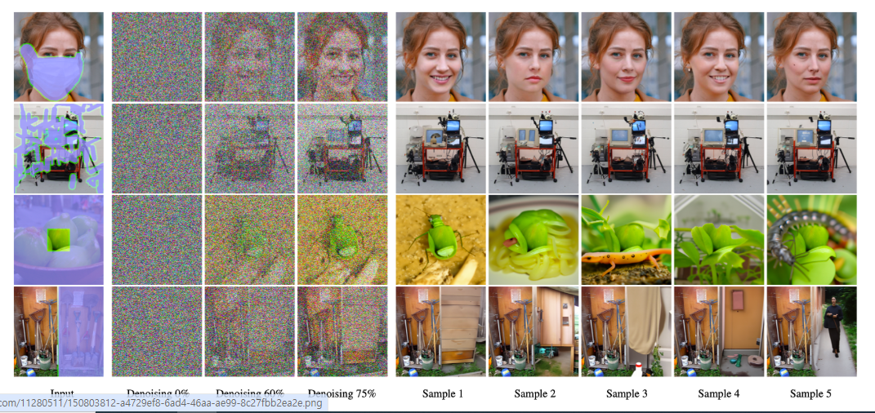
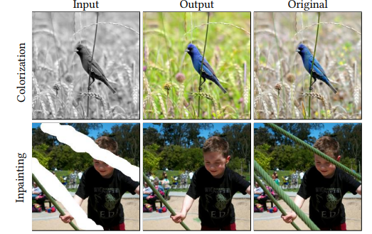
Application: Impainting, Reconstruction
2. Diffusion in Vision
Repaint
(2022)
Palette
(2022)

Slide 19
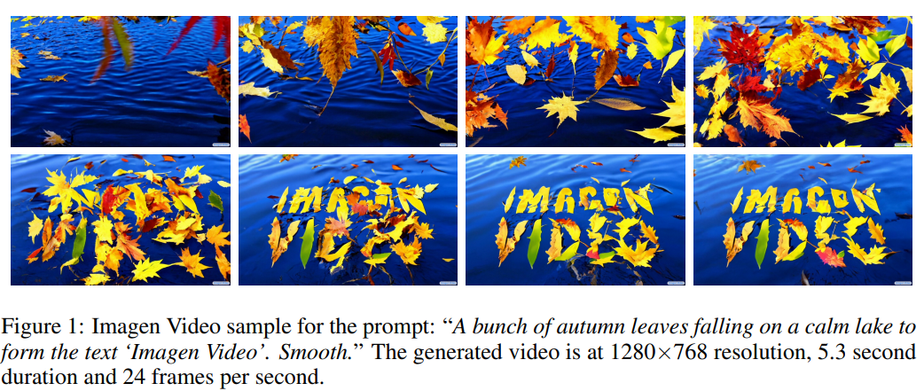

Application: Video generation
2. Diffusion in Vision
Imagen Video
(2022)
Gen Series
(Runway)

Slide 20
Diffusion Process

Slide 21
How does diffusion models work?
3. Diffusion Process
Complex data distribution
Simple prior
learning direct transformation
is hard

Slide 22
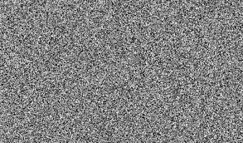
How does diffusion models work?
3. Diffusion Process
Simple prior
But going the other way—adding noise to data—is simple
Complex data
learning direct transformation
is hard
Then, let’s simply add noise step by step
and let the model learn how to denoise it, one step at a time.

Slide 23
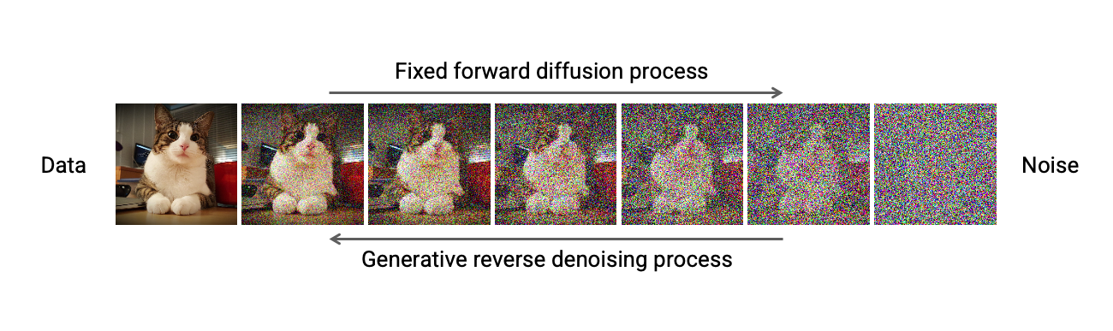
Diffusion Process
3. Diffusion Process
Forward diffusion process: Gradually adds noise to corrupt original data
Backward diffusion process: Model learns to generate data by iterative denoising

Slide 24









Diffusion Forward Pass
3. Diffusion Process
$$q\left(x_{1:T} | x_{0}\right)= \prod_{t=1}^{T}{q(x_{t}{|x}_{t−1}})$$
Define the forward process with Markov chain:
Each transition: $q\left(x_{t} | x_{t−1}\right)=N({x_{t}; \sqrt{1−β_{t}}x}_{t−1}, β_{t}I)$
$$x_{0}$$
$$x_{1}$$
$$x_{2}$$
$$x_{3}$$
$$x_{4}$$
$$…$$
$$x_{T}$$
With sufficient amount of noise and timesteps, the data eventually converges to pure noise:
$$q(x_{T})=N(x_{T}, 0, I)$$

Slide 25



Diffusion Backward Pass
3. Diffusion Process
So, if everything becomes noise... how do we get the data back?
Begin with
$$q(x_{T})=N(x_{T}, 0, I)$$
Iteratively denoise with True denoising distribution:
$q\left(x_{t−1} | x_{t}\right)∝q(x_{t−1})q(x_{t}|x_{t−1})$
Intractable
-> Let’s approximate the reverse process
$$q\left(x_{t−1} | x_{t}\right)$$
with Gaussian.

Slide 26








Diffusion Backward Pass
3. Diffusion Process
Begin with
$$p(x_{T})=N(x_{T}, 0, I)$$
Iteratively denoise with learned reverse process:
$${ p}_{θ}\left(x_{t−1} | x_{t}\right)=N({x_{t−1}; μ}_{θ}(x_{t},t), {σ_{t}}^{2}I)$$
Estimated by network
$$x_{0}$$
$$x_{1}$$
$$x_{2}$$
$$x_{3}$$
$$x_{4}$$
$$…$$
$$x_{T}$$

Slide 27
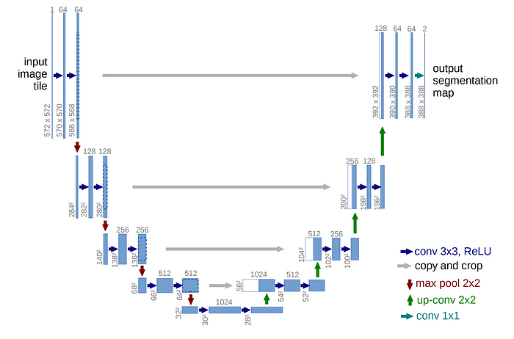
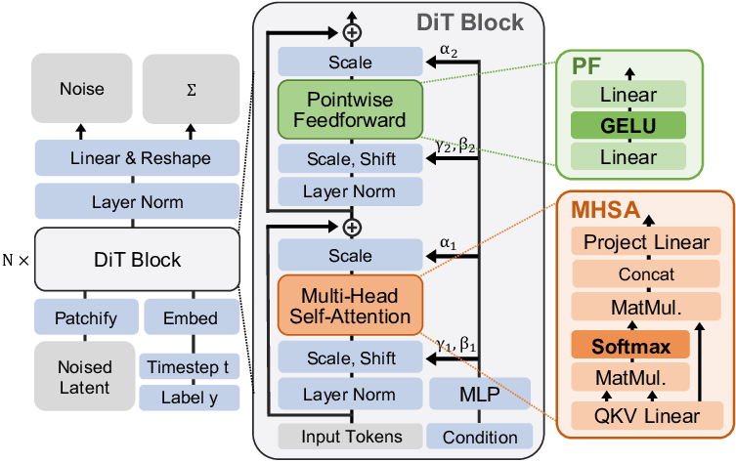
Model architecture
3. Diffusion Process
U-net
(Ronneberger et al., 2015)
DiT
(Peebles & Xie, 2022)

Slide 28
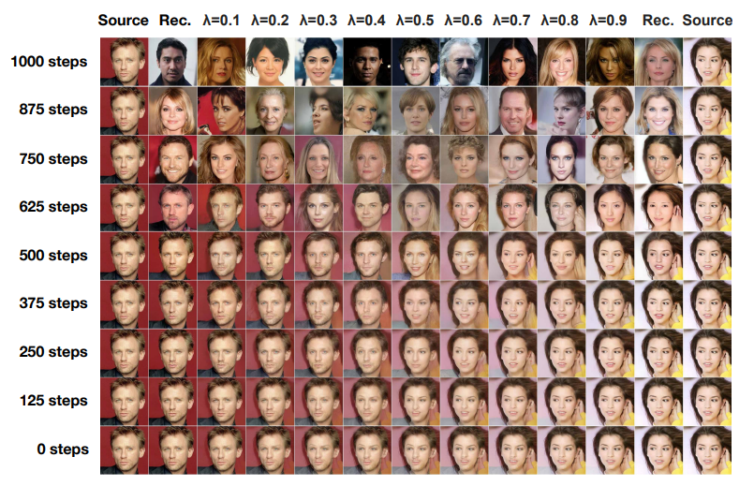
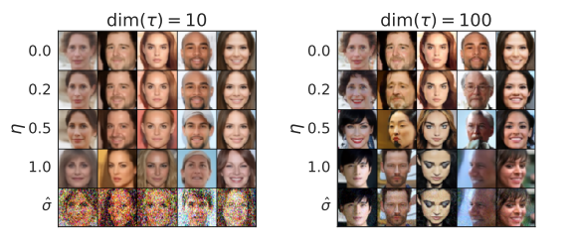
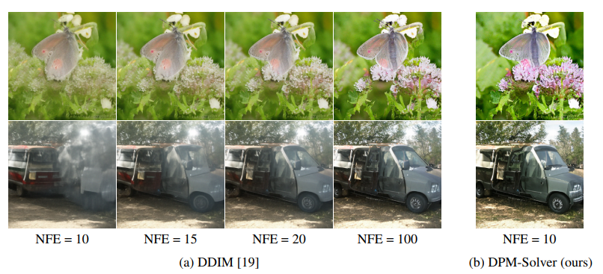
Diffusion Sampling
3. Diffusion Process
DDPM
(Ho et al., 2020)
DDIM
(Song et al., 2020)
DPM-solver
(Lu et al., 2022)

Slide 29
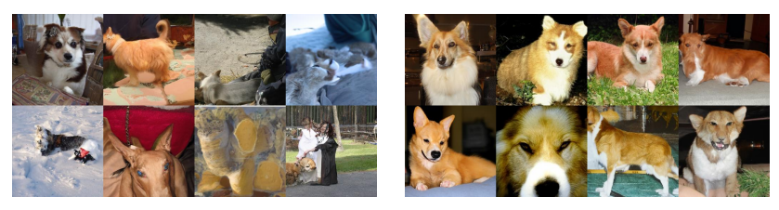
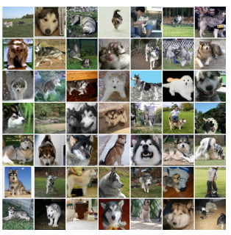
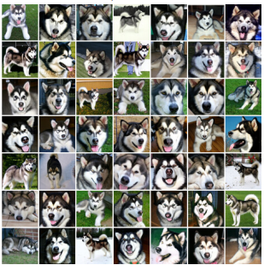
Guidance
3. Diffusion Process
Classifier-guidance
(Dhariwal & Nichol, 2021)
Classifier-free guidance
(Ho & Salimans, 2022)
Guidance with s=1
Guidance with s=10
No guidance
CFG with w=3

Slide 30
Bringing Diffusion to Language

Slide 31
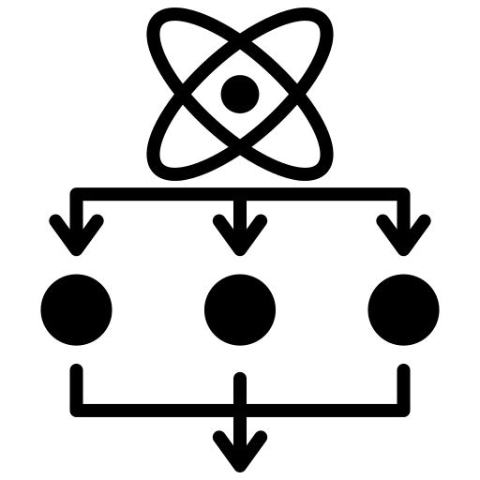



Why Use Diffusion Language Models?
4. Diffusion in Language
Autoregressive (AR) models still perform well.
So why should we consider using diffusion for language models?
Parallel Decoding
Controllability
Iterative Refinement
Bidirectional Context
All tokens can be generated simultaneously, utilizing more hardware
Generation could be easily steered with Classifier guidance, Classifier-free guidance
Allows correction of early mistakes and globally coherent outputs
Considers full sequence context during denoising, enabling infilling

Slide 32
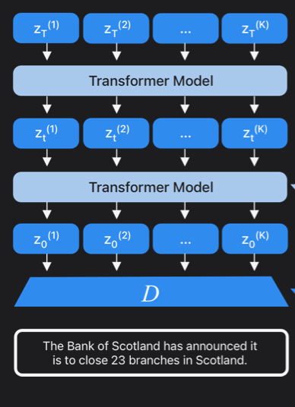
Why Use Diffusion Language Models?
4. Diffusion in Language
1. Parallel Decoding
Parallel generation enables simultaneous updates
Parallel Decoding
Controllability
Faster generation for long sequences
Better hardware utilization
Iterative Refinement
Bidirectional Context
https://machinelearning.apple.com/research/latent-language-diffusion-model

Slide 33
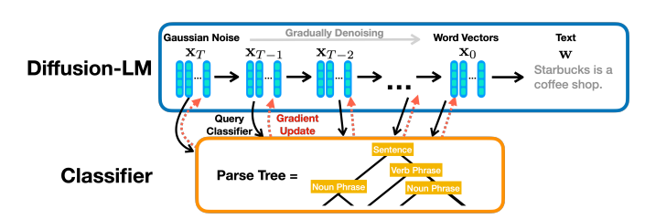
Why Use Diffusion Language Models?
4. Diffusion in Language
2. Controllability
External guidance (e.g., classifiers) can be more seamlessly integrated
The iterative nature of diffusion progressively steers the entire sequence toward the desired attributes
Parallel Decoding
Controllability
Classifier-free guidance (CFG) can also be employed to control generation without external models
Iterative Refinement
Bidirectional Context

Slide 34
Why Use Diffusion Language Models?
4. Diffusion in Language
3. Iterative refinement
Enable localized edits
Support tasks like text style transfer, error correction, or controlled rewriting
Parallel Decoding
Controllability
Prompt: Change ‘boring’ to ‘emotional’
Target: "The movie was good, but the ending was boring."
AR model
Diffusion model
The
Movie
was
The
Movie
…
boring
Iterative Refinement
Bidirectional Context
good
…
emotional
The
Movie
…
emotional
Needs to regenerate all tokens again.
Capable of refining just the targeted token

Slide 35
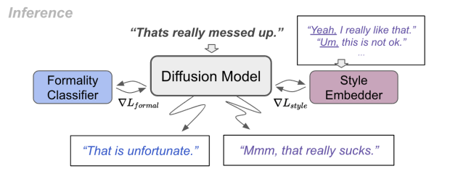
Why Use Diffusion Language Models?
4. Diffusion in Language
4. Bidirectional Context
Utilize full attention which enables the model to see bidirectional context
Helps in modeling dependencies across the entire sequence
Parallel Decoding
Controllability
Useful in infilling, style transfer, rewriting
Iterative Refinement
Bidirectional Context
https://arxiv.org/pdf/2308.15459

Slide 36
Why Diffusion Doesn’t Directly Work on Text
4. Diffusion in Language
Unlike images, text is made of discrete tokens
-> we can’t smoothly add noise like we do with pixels.
For image, when noised, still a valid image at each step
For text tokens
Text | Tokens
The cat sits on the mat | 0, 40, 43, 13, 2, 67
? ? ? ? ? ? | 0.5, 40.71, 42.1, 13.4, 1.8, 66.4
Rounding?
No image why on the love | 1, 41, 42, 13, 2, 66

Slide 37
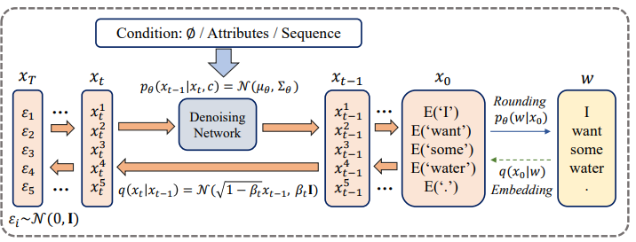
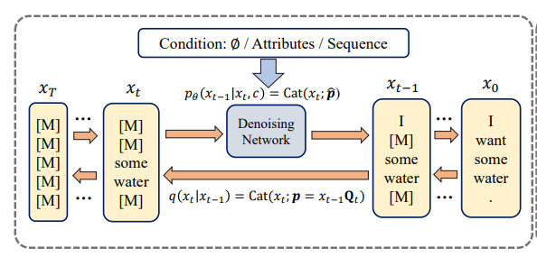
Dealing with Discreteness
4. Diffusion in Language
To apply diffusion to language, we need to bridge the gap between discrete tokens and the continuous noise-based diffusion framework.
Two main paradigms
Continuous Diffusion
Discrete Diffusion
(https://www.ijcai.org/proceedings/2023/0750.pdf)

Slide 38
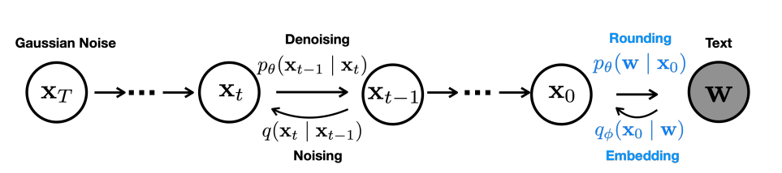
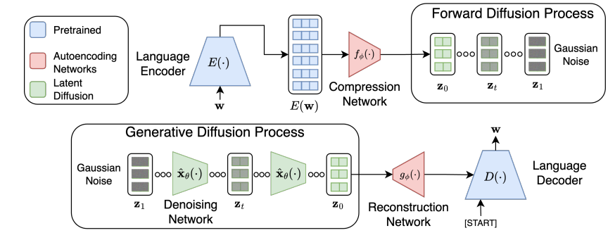
Continuous Diffusion Language Model
4. Diffusion in Language
Instead of adding noise directly to tokens, we embed tokens into a continuous space and apply diffusion there.
Embedding space
(Diffusion-LM, 2022)
Latent space
(LD4LG, 2022)
Diffusion-LM (2022), LD4LG (2022), Genie (2023), AR-Diffusion (2024)…

Slide 39
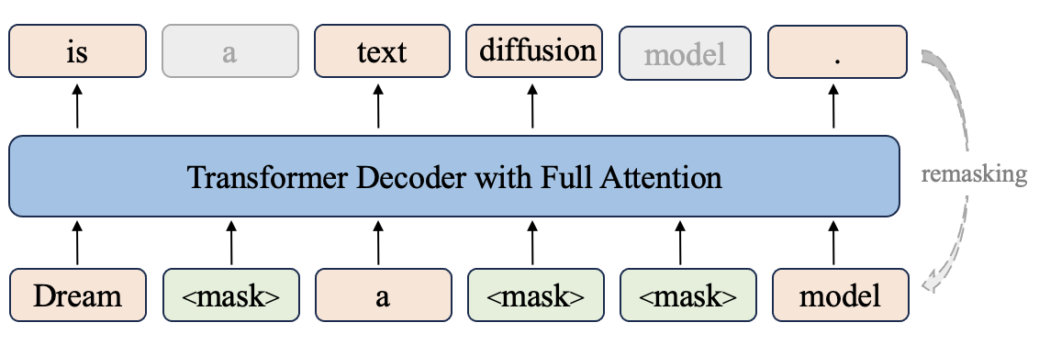
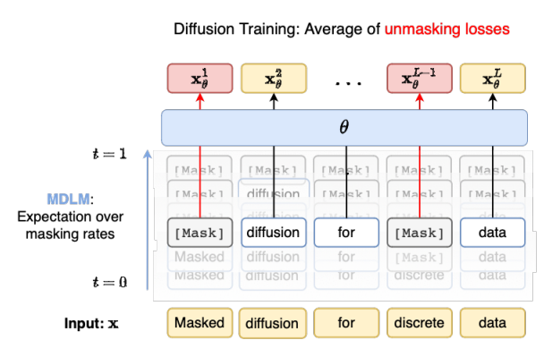
Discrete Diffusion Language Model
4. Diffusion in Language
Instead of embedding tokens into a continuous space, discrete diffusion models operate directly in token space by progressively corrupting the input sequence through symbolic operations.
Random replace, mask or shuffle
Dream
(Ye et al., 2025)
MDLM
(Sahoo et al., 2024)
DiffusionBERT (2022), MDLM (2024), SEDD (2024), LLADA (2025)…

Slide 40
Continuous VS. Discrete Diffusion
4. Diffusion in Language
Continuous Diffusion LM
Discrete Diffusion LM
Space
Embedding, Latent
Token
Noising process
Continuous noising
Masking, Replacing
Faster single-step operations (low-dim)
Classifier guidance
Image-based techniques are applicable
Works directly on tokens
Easier alignment with existing models
Simplified training objective
Pros
Training instability
Scaling to large corpora remains unproven
Requires encoder/decoder modules
Classifier guidance is limited
Transition itself is not differentiable
Cons

Slide 41
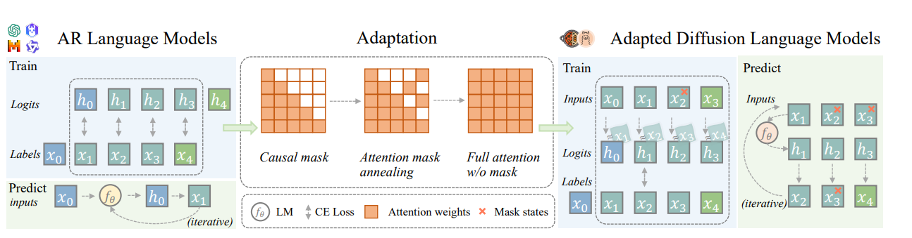
Model architecture
4. Diffusion in Language
Still uses transformer-based architecture
Attention masking is different: Causal attention -> Full attention
DiffuLLaMA (2025)

Slide 42
Diffusion Language
Models Today

Slide 43
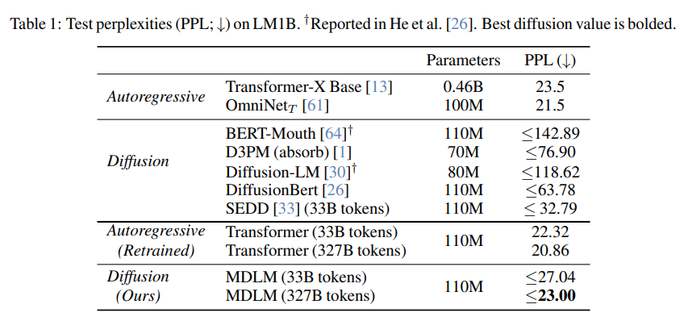
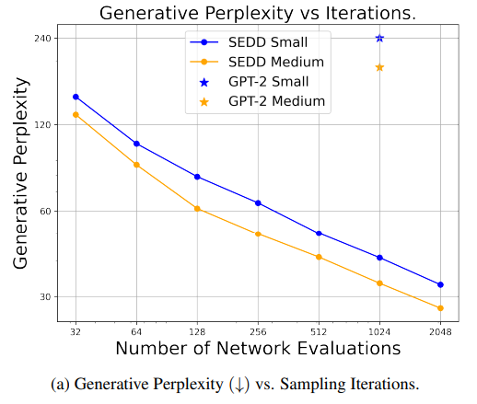
Fluency
5. DLMs Today
One of the major challenges in diffusion language models has been limited fluency, as parallel generation can disrupt token-level coherence.
However, recent advances in discrete score matching theory have significantly mitigated this issue, leading to substantial improvements in generation quality.
MDLM (2024)
SEDD (2024)

Slide 44
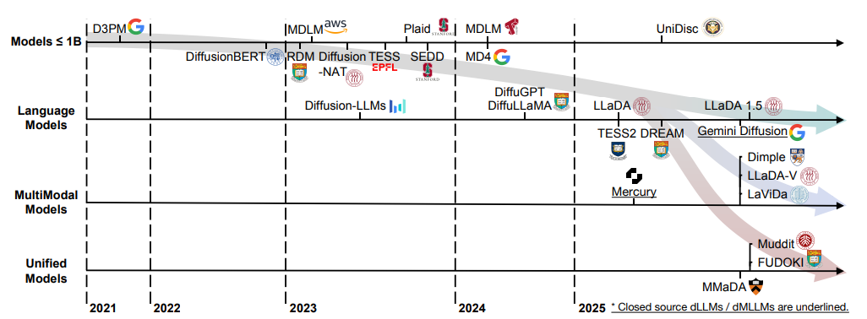
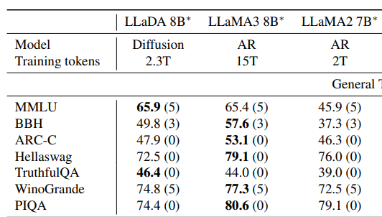
Scalability
5. DLMs Today
Due to the high training cost and instability, diffusion language models have not been scaled as effectively as autoregressive models
However, since the introduction of DiffuLLaMA and LLaDA, several works have emerged to tackle these limitations.

Slide 45
Scalability
5. DLMs Today
Still, models larger than 13B have yet to be developed, and further advancements are needed.
Future directions may include:
Adapting large autoregressive models for diffusion
Incorporating Mixture-of-Experts (MoE) architectures
Exploring scalable training frameworks or memory-efficient sampling methods
DiffuLLaMA (2025)

Slide 46
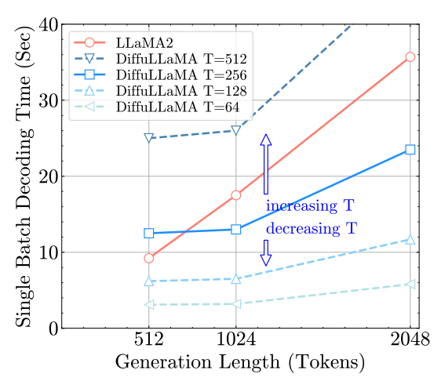
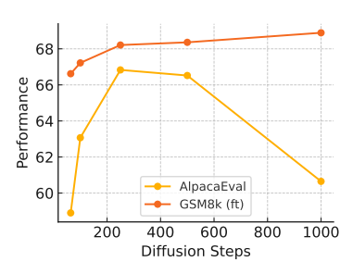
Decoding Speed
5. DLMs Today
Parallel generation gives diffusion models the potential to surpass autoregressive models in speed.
However, they are not yet faster in practice, primarily due to:
The need for multiple iterative steps to produce stable outputs
The absence of KV-caching mechanisms, as diffusion models typically rely on full attention at every step.
DiffuLLaMA (2025)
TESS2 (2025)
https://arxiv.org/pdf/2410.17891
https://arxiv.org/pdf/2502.13917

Slide 47


Decoding Speed
5. DLMs Today
While models like Gemini Diffusion and Mercury have demonstrated impressive speed, their exact approaches remain unclear.
This leaves significant room for improvement in areas such as:
Distillation techniques for faster inference
Introducing KV-caching mechanisms for diffusion models
SDTT (2025)
dKV-cache (2025)

Slide 48

Generation Length
5. DLMs Today
Due to the constraints of parallel generation, diffusion language models are typically limited to fixed-length outputs
This limits their efficiency, especially for short sequences or variable-length generation.
Recent works have begun addressing this limitation through block-wise diffusion processes, which generate text one block at a time.
Block-diffusion (2025)

Slide 49


Reasoning Capability
5. DLMs Today
Diffusion models generate in parallel or by blocks, making it hard to revise their thinking in mid-generation like autoregressive mode
Reasoning requires token-level dependencies and iterative reinforcement, which diffusion models struggle to capture.
Recent works have begun to tackle this challenge.
DoT (2024)
d1 (2025)

Slide 50


Multi-modal Input
5. DLMs Today
While current LLMs are widely used as backbones in vision-language models, the adoption of diffusion language models in this space is still in its early stages.
Unlike autoregressive models, which generate outputs sequentially and often require modality-specific designs for audio or image generation, diffusion LMs offer parallel generation.
This shared parallelism across modalities makes diffusion LMs a promising candidate for unified multimodal generation frameworks.
Transfusion (2024)
LLADA-V (2025)

Slide 51
Some other directions might include
5. DLMs Today
Alignment: Adapting reward modeling and RLHF techniques to the diffusion setting
Personalization: Tailoring generation based on user-specific traits or preferences
Domain adaptation: Fine-tuning diffusion models to perform well in specialized domains (legal, medical)
Decoding method: Integrate speculative decoding, logit-based merging to improve the quality
Interpretability: Investigating how diffusion updates correspond to semantic transformations
Pretraining/finetuning objectives: Alternative training losses or learning strategies
Pruning: Reducing inference cost by removing redundant calculation
Integrating RAG system: Combining diffusion models with retrieval-augmented generation (RAG) frameworks

Slide 52
Seminar Schedule

Slide 53
14-Week Schedule
0. Schedule
Week | Topic | Contents
Week 1 (06/25) | Introduction to Diffusion Model
Week 2 (07/02) | Generative Modeling Ⅰ | What is generative modeling? AE, VAE, GAN, AR
Week 3 (07/09) | Generative Modeling Ⅱ | Mathematical Formulation Probability, ELBO, NELBO, VQ-VAE
Week 4 (07/16) | Diffusion Sampling Ⅰ | DDPM Training, Sampling, Noise schedule
Week 5 (07/23) | Diffusion Sampling Ⅱ | SDE, Score Matching DDIM, DPM-Solver
Week 6 (07/30) | Diffusion in Vision | Evolution in Vision Diffusion Latent Diffusion, DiT, ControlNet…
Week 7 (08/06) | Technical Components | Guidance (Classifier guidance, CFG) Self-conditioning, Distillation

Slide 54
14-Week Schedule
0. Schedule
Week | Topic | Contents
Week 8 (08/13) | Diffusion Language Model Ⅰ | Continuous Diffusion Language Models Embedding, Latent
Week 9 (08/20) | Diffusion Language Model Ⅱ | Discrete Diffusion Language Models Discrete, Masked Diffusion Models
Week 10 (08/27) | Diffusion Language Model Ⅲ | AR VS. NAR Block-wise Diffusion, AR like formulation
Week 11 (09/03) | Diffusion Language Model Ⅳ | Recent Advances in DLMs Scaling, Reasoning, Caching
Week 12 (09/10) | Deeper: Score Matching & EBM | Score Matching Energy-based Diffusion Models
Week 13 (09/17) | Deeper: Flow Matching | Intro to Flow matching Flow matching VS. Diffusion
Week 14 (09/24) | Research Trends (ICML Review)
*See this for related papers: https://github.com/KIM-JAKE/Awesome-Diffusion-LLM

Slide 56


SDE & Score Matching
3. Diffusion Process
Ideally, we’d like to model diffusion as a continuous-time process rather than discrete steps.
In this view, the forward process becomes a stochastic differential equation (SDE).
From https://cvpr2022-tutorial-diffusion-models.github.io/
We’ll come back to this topic in a future session

